Slide 1
AI Course
Under the supervision of:
Samsung
Innovation
Campus

Slide 2


AI Course
Presented By:
Wessam Salah Walid
https://www.linkedin.com/in/wessamwalid/
Yousr Ashraf Hegy
https://www.linkedin.com/in/yousrhejy

Slide 3
HEART DISEASE PREDICTION
Supervised By:
Instructor: Dr. Doaa Mohamed
Facilitator: Eng. Shaimaa
3

Slide 4
AGENDA
1
2
Problem Statement
Key Findings
Address the problem we need to find a solution for
Demonstrate findings discovered upon analysis
3
4
Preprocessing
Models & Evaluation
Describe our process in making our data suitable for conducting analysis
Models tested and comparison
4

Slide 5
1
PROBLEM STATEMENT & DESCRIBTION
What’s our problem and what do we need to achieve?
5

Slide 6

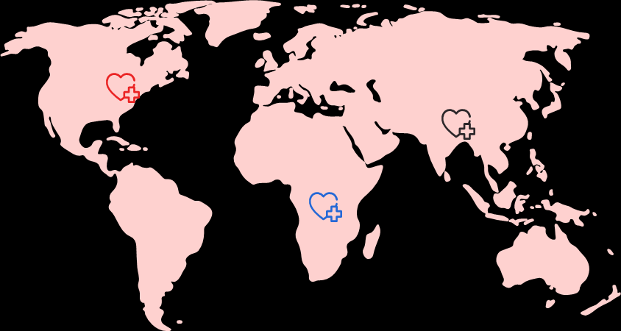
PROBLEM STATEMENT:
Cardiovascular diseases are one of the main causes of global death, taking an estimated 17.9 million lives each year, which represents about 31% of global deaths. Nowadays more people tend to depend on convenience food due to our packed schedules. Meanwhile, it has been reported that heart diseases are in constant increase the past few years and many are unaware of this.
6
Notes:
Our goal: Nutritionists/health applications need to keep track of their patients health in order to prevent them from getting any heart diseases, so we are going to represent a simple application based on machine learning to help predict if the patient is prone for having a heart disease.

Slide 7
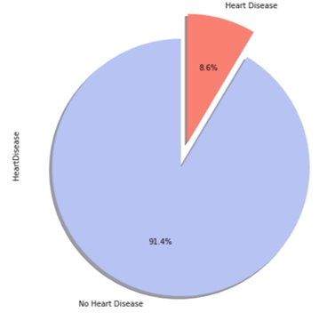
AN OVERVIEW
Our Data Comes from 2020 annual CDC survey data of 400k adults related to their health status, which conducts annual telephone surveys to gather data on the health status of U.S. residents.
The set consists of 319795 rows and 18 columns.
The data set is highly imbalanced and doesn't contain any missing values as we a large ratio for people without HD than others and this indicates imbalanced data.
Our Target is to predict if the patient has Heart Disease or not.
About 27373 of Adult have Heart disease and 292422 doesn’t have Heart Disease.
7
Notes:
CDC -> Center for disease control and prevention
Established in 1984 with 15 states, BRFSS now collects data in all 50 states as well as the District of Columbia and three U.S. territories. BRFSS completes more than 400,000 adult interviews each year, making it the largest continuously conducted health survey system in the world.".

Slide 8
DATA DESCRIPTION
1
Heart Disease:
Have you ever had a heart attack?
(Yes / No)
5
Stroke :
Have you ever had a stroke? (Yes / No)
6
Physical Health :
How many days during the past 30 days was your physical health not good? (0-30 days)
2
BMI: Body Mass Index
7
Mental Health :
How many days during the past 30 days was mental health not good? (0-30 days)
3
Smoking :
Have you ever smoked? (Yes / No)
8
DiffWalking:
Difficulty walking or climbing stairs (Yes / No)
4
Alcohol Drinking :
Have you ever drank alcohol (Yes / No)
9
Sex :
Male or Female
8
Notes:
The data set consists of 319795 rows and 18 columns.

Slide 9
DATA DESCRIPTION
10
Age Category :
Thirteen-level age category
14
GenHealth :
General Health
11
Physical Activity :
Doing physical activity or exercise during the past 30 days other than their regular job (Yes / No)
15
SleepTime:
Hours of sleeping in 24-hour period
16
Asthma :
Ever told you had asthma? (Yes / No)
12
Race :
Ethnicity
17
Kidney Disease :
Ever told you had kidney disease? (Yes / No)
13
Diabetic :
Ever told you had diabetes? (Yes / No)
18
Skin Cancer :
Ever told you had skin cancer? (Yes / No)
9

Slide 10

A PICTURE ALWAYS REINFORCES
THE CONCEPT
Key Findings
10

Slide 11
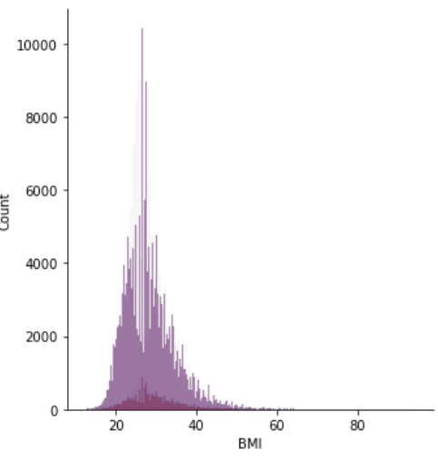
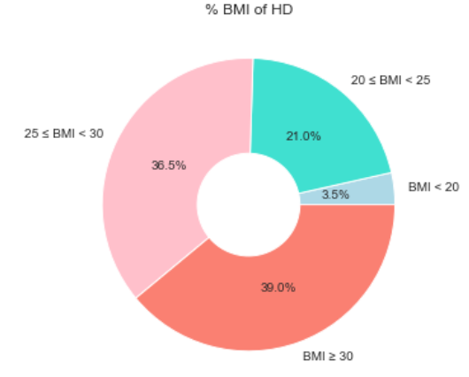

Heart Disease and BMI
As the body shape index increases, the risk of getting the disease increases which is also stated by British Heart Foundation.(https://www.bhf.org.uk/informationsupport/riskfactors/obesity#:~:text=How%20does%20obesity%20increase%20the%20risk%20of%20heart%20and%
20circulatory%20diseases%3F&text=Excess%20weight%20can%20lead%20to,lead%20to%20a%20heart%20attack. )
11

Slide 12
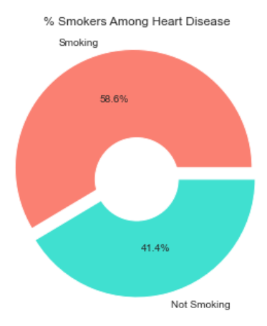
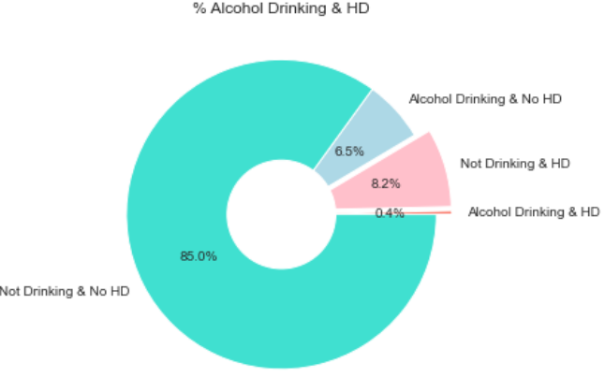
Smoking and Alcohol Drinking
People who smokes are most vulnerable to toxic effects on health and cardiovascular systems which is proved by FDA. That's besides BHF that stated the dangerous effect of drinking alcohol on patients.
(https://www.fda.gov/tobacco-products/health-effects-tobacco-use/how-smoking-affects-heart-health)(https://www.bhf.org.uk/informationsupport/heart-matters-magazine/medical/effects-of-alcohol-on-your-heart)
12
Notes:
Two different graphs
1. Smoking: Cigarats components cause inflammation to BV -> narowing -> Cardiovascular conditions
FDA -> USA food and drug administration.
2. Alcohol -> Too much alcohol can raise blood pressure and weight -> hypertension -> increasing risk of a heart attack, stroke
BHF

Slide 13
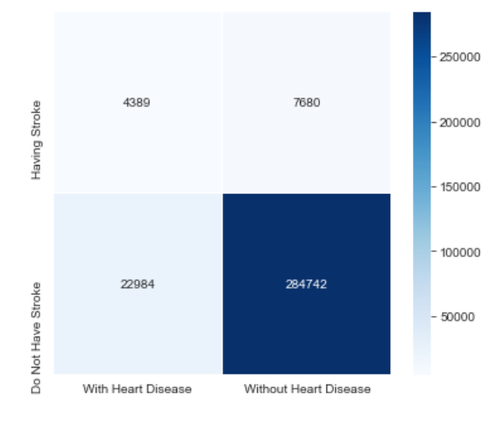
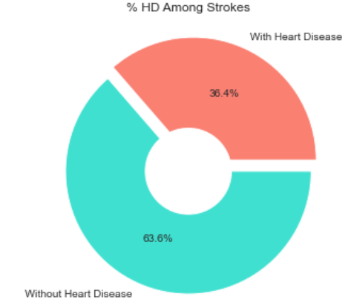
Strokes and Heart disease
Here are the people to have HD without strokes are small, and that is because the data isn’t balanced.
According to CDC, people with HD are also vulnerable to having strokes because it's an important risk factor that affects cardiovascular diseases due to unhealthy lifestyles and physical inactivity.
(https://www.cdc.gov/chronicdisease/resources/publications/factsheets/heart-disease-stroke.htm#:~:text=Making%20blood%20sticky%20and%20more,and%20narrowing%20of%20blood%20vessels)
13
Notes:
Increasing the buildup of plaque (fat, cholesterol, calcium, and other substances) in blood vessels.
Causing thickening and narrowing of blood vessels.

Slide 14
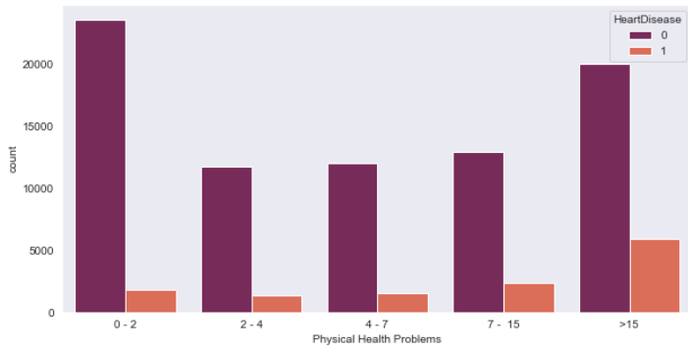
Physical Health Problems:
Symptoms of Heart disease include:
Chest pain, chest tightness, and Angina
Shortness of breath
Pain and coldness in the legs or arms.
14
Notes:
chest discomfort (angina)

Slide 15
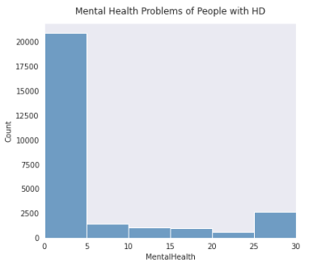
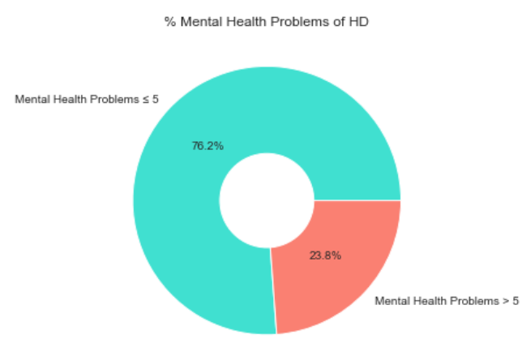
Mental Health Problems and HD:
According to CDC, there is a strong relation between mental health problems and heart disease.
(https://www.cdc.gov/heartdisease/mentalhealth.htm)
15
Notes:
People experiencing depression, anxiety, stress, and even PTSD over a long period of time may experience certain physiologic effects on the body, such as increased cardiac reactivity (e.g., increased heart rate and blood pressure), reduced blood flow to the heart, and heightened levels of cortisol.

Slide 16
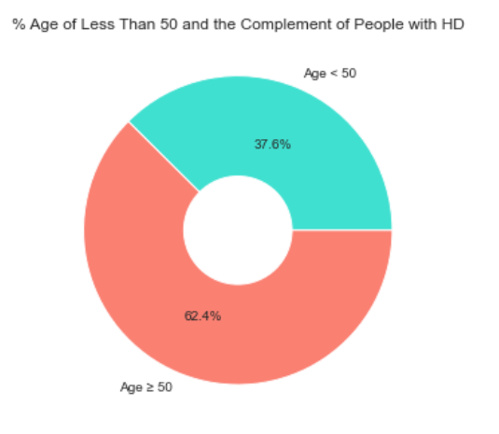
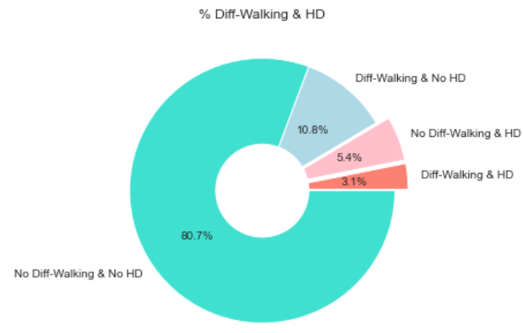
Difficulty walking and Age Category
It is clear that old people are exposed to such a disease easily more than young people and sometimes they are even according to CDC (https://www.cdc.gov/heartdisease/any_age.htm)
16

Slide 17
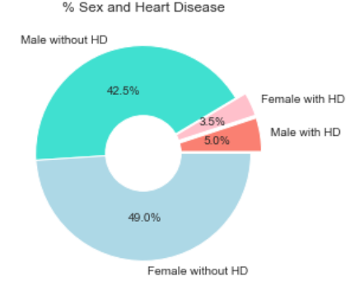
Gender and Heart Disease:
The CDC stated that despite the increases in awareness over the past decades, only about half 56% of women recognize that heart disease is their number 1 killer as HD develops 7 to 10 years later in women than men. In addition, women were more likely than men to be older and have a more complicated medical history at the time of their heart attacks.
17
Notes:
chest discomfort (angina)

Slide 18
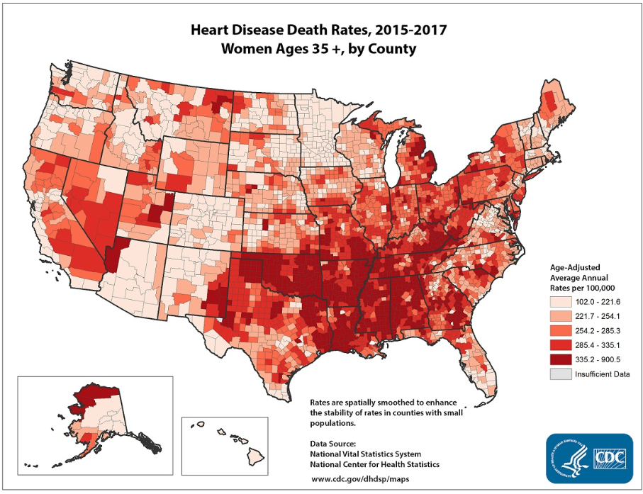
Gender and Heart Disease:
According to CDC, This map shows death rates from heart disease in women in the United States. The darker red indicates a higher death rate. (https://www.cdc.gov/heartdisease/women.htm)
18
Notes:
chest discomfort (angina)

Slide 19
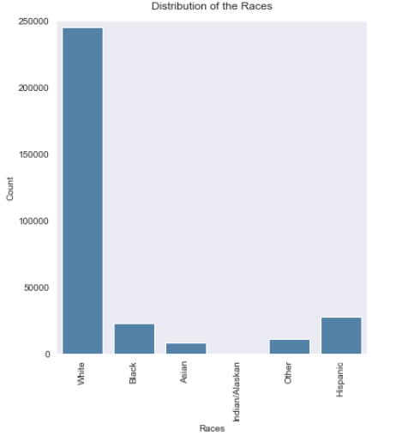
Race and Heart Disease:
As the Cleveland Clinic website, black people are more vulnerable to heart disease than white people according to some diagnoses, due to the health disparities of race and ethnicity. (Heart Disease Risk: How Race and Ethnicity Play a Role (clevelandclinic.org))
19

Slide 20
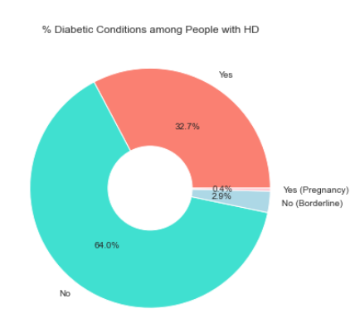
Diabetes and Heart Disease
According to CDC, The risk of death from heart disease for adults with diabetes is higher than for adults who do not have diabetes
as Diabetes causes sugar to build up in the blood. (https://www.cdc.gov/diabetes/library/features/diabetes-and-heart.html#:~:text=Over%20time%2C%20high%20blood%20sugar,and%20can%20damage%20artery%20walls)
20
Notes:
high blood sugar -> damage blood vessels and the nerves that control your heart.

Slide 21
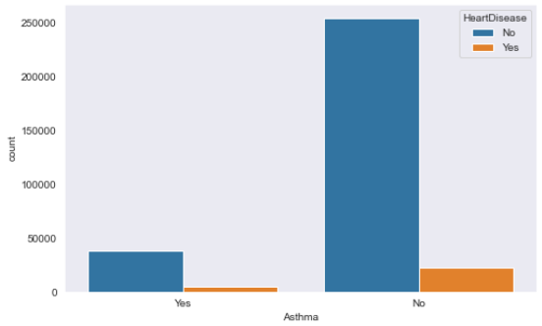
Asthma Heart Disease:
Previous studies have associated asthma with an increased risk of cardiovascular conditions, including
Heart attack and cardiovascular disease.
21
Notes:
High blood pressure is a leading cause of heart disease and stroke because it damages the lining of the arteries, making them more susceptible to the buildup of plaque, which narrows the arteries leading to the heart and brain.

Slide 22
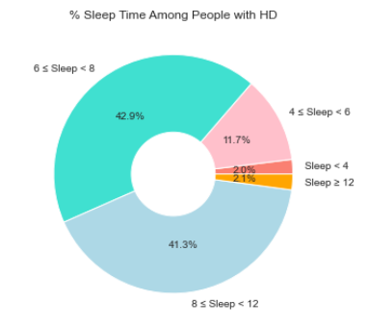
Sleep time and Heart Disease:
Going to sleep between 10:00 and 11:00 pm is associated with a lower risk of developing heart and circulatory disease compared to earlier or later bedtimes. According to CDC, Adults who sleep less than 7 hours each night are more likely have health problems, including heart attack, asthma, and depression.
(How Does Sleep Affect Your Heart Health? | cdc.gov)(Too Much Sleep May Bring Heart Disease, Death Risk (webmd.com))
22
Notes:
chest discomfort (angina)

Slide 23
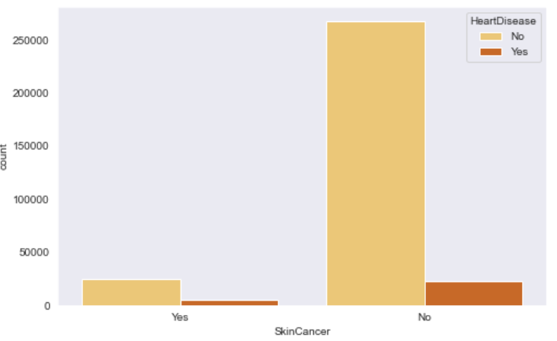
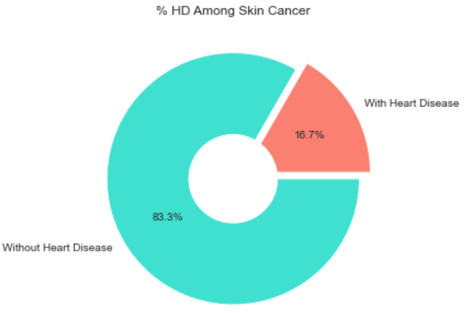
Skin Cancer and Heart Disease
It is clear from the graphs above that there is a very weak relationship between skin cancer and heart disease.
23

Slide 24
3
Data Preprocessing
What’s should be done for data to fit into the models?
24

Slide 25
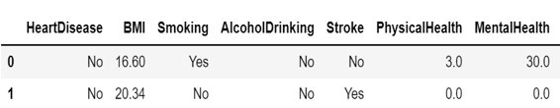
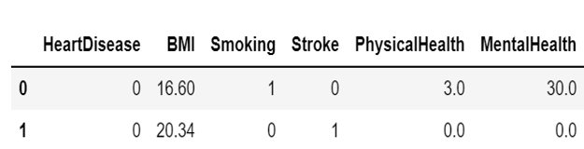
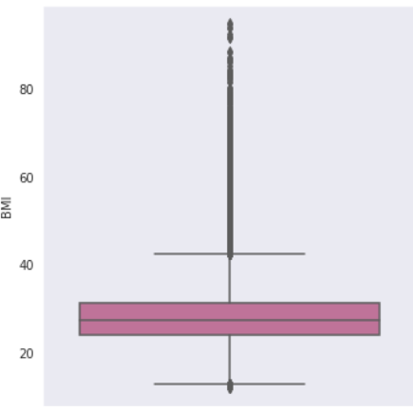
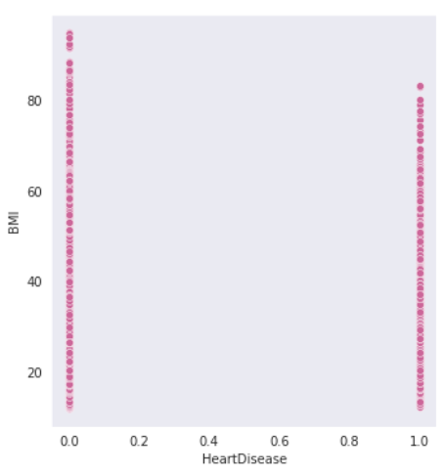
Preprocessing stages:
Checking null values.
Encoding categorical data. Remove Unnecessary features.
Handling outliers
25

Slide 26
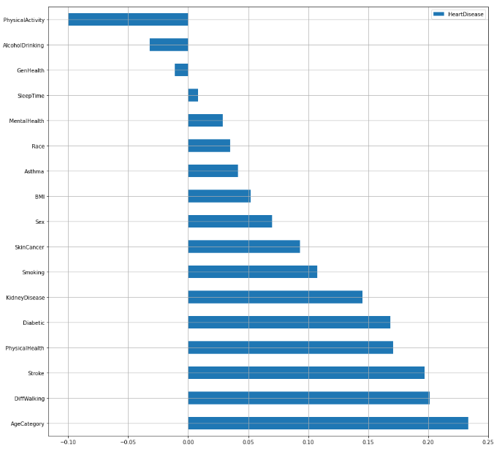
Preprocessing stages:
We found a lot of weak relationships in our dataset like: SkinCancer & AgeCategory with a ratio of 0.26 and the stronge relations like one between DiffWalking & PhysicalHealth with a ratio of 0.43 and between KindneyDisease & HeartDisease with a ratio of 0.15.
Imbalanced data Handling
Near Miss Sampling
Random UnderSampling
Random OverSampling
Smote Sampling
26

Slide 27

Modeling and Prediction
27

Slide 28
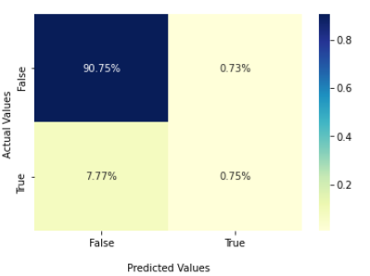
Logistic Regression Classifier:
Without using Sampling:
Accuracy: 91.5%
Precision: 92%
Recall: 99%
This model guess the TN more than TP
28
Notes:
Precision for negative = 95
when it predicts that a patient has heart disease, it is correct around 90% of the time.
for all the patients who actually have heart disease, 98 correctly identified as having a heart disease

Slide 29
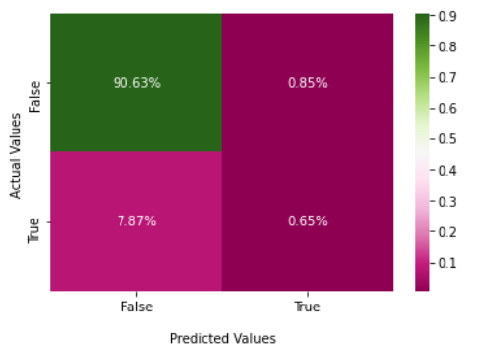
KNieghbours Classifier:
This model also doesn't need Sampling as it is not influenced in any way by the size of the class:
Accuracy: 91.28%
Precision: 92%
Recall: 99%
It is a good indicator for TN not for TP
29

Slide 30
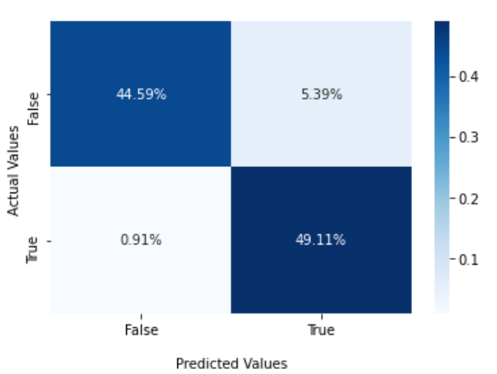
Random Forest Classifier:
Using Random OverSampling:
Accuracy: 93.72%
Precision: 98%
Recall: 89%
This model Guesses the TP more than TN
30
Notes:
Precision for negative = 95
when it predicts that a patient has heart disease, it is correct around 90% of the time.
for all the patients who actually have heart disease, 98 correctly identified as having a heart disease

Slide 31
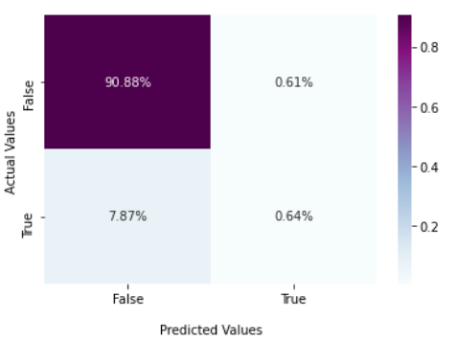
XGBoost Classifier:
This model deosn't need sampling cause it is known with its great ability to handle overfitting and imbalanced data and This model Guesses the TN way more than TP
Accuracy: 91.97%
Precision: 92%
Recall: 99%
31

Slide 32
The Best Model for our data is:
Random Forest Classifier:
It produces the best accuracy, which is about 94% under the condition of oversampling, besides that, it predicts the true positives and true negatives in nearly equal ranges unlike other models that only guess the true negatives with high ranges.\
The best-used sampling way is Random over sampling method
33

Slide 33
Conclusion:
Decrease Heart Disease through:
1. Healthy lifestyle and Diet.
2. More physical activities and have regular excersize.
3. Stop smoking and Alcohol drinking.
4. Keep your blood pressure under control.
33

Slide 34
THANKS!

